Slide 1


Slide 2

We use cause and effect to infer a logical outcome
In poetry we use logic to infer what the meaning is when it is sometimes unclear
Metaphor: Her hair was gold.
-we know her hair wasn’t
metal but can infer it was
shiny and blonde

Slide 3

However, there is a type of poetry called “Nonsense Poetry” in which it is harder to decipher what the poet is saying.

Slide 4
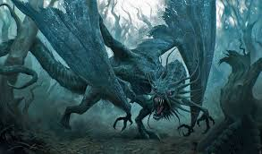
Jabberwocky Poem
By Lewis Carroll

Slide 5
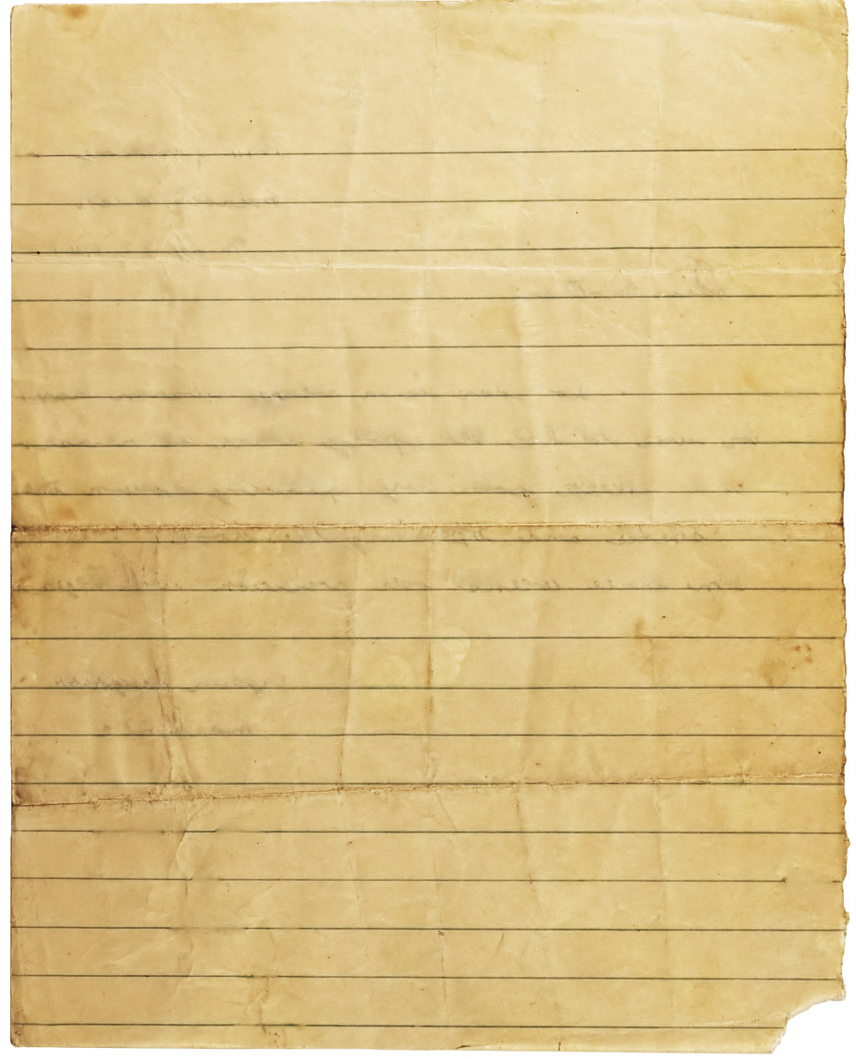

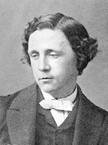
Lewis Carroll
Lewis Carroll
Math professor in mid 1800s
Wrote many books on math and logic
Wrote “Alice in Wonderland” and “Through the Looking Glass”
Author of the “Jabberwocky” poem-one of most famous nonsense poems
Poem in written in “Through the Looking Glass”
Math professor in mid 1800s
Wrote many books on math and logic
Wrote “Alice in Wonderland” and “Through the Looking Glass”
Author of the “Jabberwocky” poem-one of most famous nonsense poems
Poem is written in “Through the Looking Glass”

Slide 6
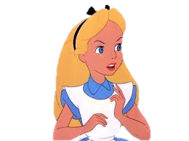
“It seems very pretty…but it’s rather hard to understand!...Somehow it seems to fill my head with ideas-only I don’t exactly know what they are. However, somebody killed something: that’s clear, at any rate.” -Alice, Through the Looking Glass

Slide 7
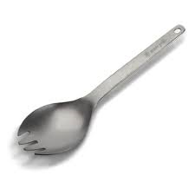
Portmanteau Words
New words that are formed from two words or parts of words which are fused to give new meaning
Examples:
Brunch-Breakfast and lunch
Ginormous-Gigantic and enormous
Brangelina-Brad Pitt and Angelina
*Chortle-chuckle and snort

Slide 8
Can you find some Portmanteau words in the Jabberwocky poem?

Slide 9
Some Portmanteau Words found in the poem:
1)frumious (fuming, furious)
2) uffish (gruffish, roughish, huffish)
3) burble (bleat, murmer, warble)
4) mimsy (flimsy, miserable)
5) mome (from home)
6) galumph (gallop, jump)
7) slithy (lythe, slimy)
8) frabjous (fabulous, joyous)
9) chortle (chuckle, snort)

Slide 10
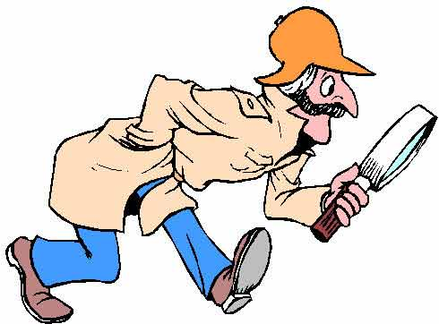
In groups, take stanza you have been given and, decipher what is happening in the plot

Slide 11
1 – the first stanza is a type of "background" exposition, the time – "coloring" the poem's mood
2 - Warning: Someone talks to someone (his son/daughter) telling him/her to be careful from different things
3 - Going on the quest: the son takes a sword, looks for something, rests by a tree 4 - Arrival of the foe: As he stands in thought, a Jabberwocky appears – its description is given 5- The battle: What does the hero/heroine do? Fights with it, kills it and goes back with his head victorious 6 - Hero's welcome: the father is very glad to see him/her (chortled in his joy, come to my arms!)
7 - Repeat the first stanza: the time in which the poem is told or in which the story started taking place

Slide 12
L.Carroll shows us with enough recognizable words and proper organization of language we can still figure out the plot.

Slide 13

Portmanteau Mad Lib Time!!

Slide 14
*all must be portmanteau words except for numbers
1-adjective 2-name 3-noun 4-adjective 5-noun 6-adjective 7-adjective
8-plural noun 9-noun 10-number 11-shape 12-food 13-food 14-number

Slide 15
Pizza was invented by a ___1__ chef named__2__. To make pizza, you need to take a lump of__3___, and make a thin, round ___4__ __5___. Then you cover it with__6___ sauce, ___7___ cheese, and fresh chopped__8___. Next you have to back it in a very hot___9__. When it is done, cut it into__10_ __11____. Some kids like__12___ pizza the best, but my favourite is the__13___ pizza. If I could, I would eat pizza _14__ times a day!

Slide 16
*all must be portmanteau words except for numbers
1-adjective
2-adjective
3-adjective
4-adjective
5-noun
6-adjective
7-adjective
8-noun
9-verb
10-verb
11-adjective
12-noun
13-verb
14-noun
15-verb
16-adjective
17-noun
18-adjective

Slide 17
I walk through the__1__ jungle. I take out my__2__canteen. There’s a__3__parrot with a__4__ __5__ in his mouth in the __6__ trees. I gaze at his__7__ __8__. A sudden sound awakes me from my daydream. A panther__9__ in front of my head. I__10__ his__11__breath. I remember I have a packet of__12__that makes it go into a deep slumber. I__13__it away in front of the__14__. Yes, he’s eating it. I__15__away through the __16__jungle. I meet my parents at the__17__. It’s been an__18__ day.

